Slide 1

RESTAURANT EXPANSION PROJECT
Devendra Mehta
12/03/2025
Data Analysis to Guide New Restaurant Openings
Location, Cuisine, and Service Strategy

Slide 2

Project Overview
Introduction: Zomato commands a significant 58% market share in India's competitive food delivery landscape.
Problem: Zomato aims to grow its business by expanding its restaurant presence. To do this effectively, they need to identify the best locations and strategies for opening new restaurants.
Objective: This project will use data analysis to recommend optimal strategies and locations for Zomato to successfully expand its restaurant network. Our goal is to find markets with less competition and high customer interest.

Slide 3
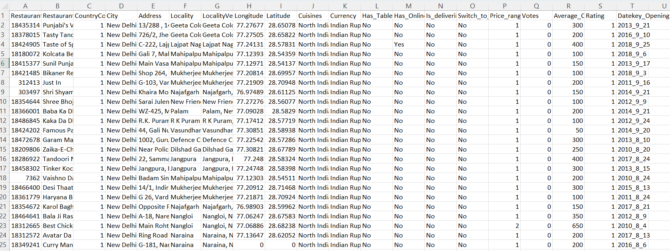
Problem Statement
You are hired as a consultant data analyst by zomato where the team is looking for expansion and opening restaurants. Your task is to come up with strategies/suggestions about opening newer restaurants.

Slide 4
The image above displays details about Zomato Sales Performance, including:
Restaurant ID: Unique identifier for each restaurant.
Restaurant Name: The name of the restaurant.
CountryCode: Country code of the location where the restaurant is situated.
City: The city where the restaurant is located.
Address: The specific address of the restaurant.
Locality: The locality or neighborhood where the restaurant is situated.
Locality Verbose: Detailed information about the locality.
Longitude: The geographical longitude coordinate of the restaurant.
Latitude: The geographical latitude coordinate of the restaurant.
Cuisines: The type of cuisine offered by the restaurant.
Currency: The currency used for transactions in the restaurant.
Has_Table_booking: Indicates whether the restaurant has a table booking option (Yes/No).
Has_Online_delivery: Indicates whether the restaurant offers online delivery (Yes/No).
Is_delivering_now: Indicates whether the restaurant is currently delivering (Yes/No).
Switch_to_order_menu: Indicates whether users can switch to the order menu (Yes/No).
Price_range: A numeric value indicating the price range category of the restaurant.
Votes: The number of votes or ratings/(feedback) received by the restaurant.
Average_Cost_for_two: The average cost for two people dining at the restaurant.
Rating: The overall rating of the restaurant is based on user reviews.
Datekey_opening: The date when the restaurant was opened.

Slide 5
Data Snapshot
Restaurants: Analysis includes a substantial dataset of 9,551 restaurants.
Global Reach: Data spans 15 countries, 141 cities covering 1,208 localities, offering a broad geographical perspective.
Cuisine Variety: The dataset encompasses restaurants serving an impressive 1,825 different cuisines, showcasing market diversity.
Delivery Landscape: Notably, only 25.7% of restaurants offer online delivery, indicating a potential area for expansion.

Slide 6
Analytical Methods And Tools Used
Data Preparation and Cleaning:
Initial cleaning used standard spreadsheet functions to remove duplicates and trim whitespaces, ensuring data consistency.
Missing cuisine details were replaced with the most common cuisine in each country.
Missing longitude and latitude values were imputed using average coordinates of restaurants within the same locality.
Missing 'average cost for two' was filled with the average cost for restaurants in each city.
Data Enrichment and Feature Creation:
The VLOOKUP function was used to create a 'Country' column, referencing a separate 'Country Code Description' table.
Text functions were employed to extract currency abbreviations.
The Text to Columns tool was utilized to extract 'Year', 'Month', and 'Date' components from the 'Year_opening' column.
Text functions were used to create a average cost for two with currency abbreviation column.
VLOOKUP was then applied with a newly created 'Conversion Rates' table to calculate 'average cost in USD' for standardized cost comparison.

Slide 7
Descriptive and Comparative Analysis:
To identify optimal expansion markets, PivotTables were used to compare countries and cities based on restaurant density, customer engagement (Engagement Score), and average price range.
Google Sheet’s descriptive statistics functions like SUM, AVERAGE, and COUNTIF were utilized to calculate metrics such as total counts, averages, and frequencies.
PivotTables were used to facilitate data summarization and exploration of key metrics.
Correlation Analysis:
To explore the relationship between pricing and customer satisfaction, a correlation analysis was conducted. Specifically, scatter plots were generated to visualize the relationship between the average price of cuisines (in USD) and the average restaurant ratings.
Trend Analysis:
To identify patterns and changes over time, trend analysis was performed. Google Sheet’s line graphs and other chart types were used to visualize trends.
Data Visualization:
Google Sheet's charting tools were used to generate visualizations to effectively communicate significant trends and relationships identified in the analysis.

Slide 8
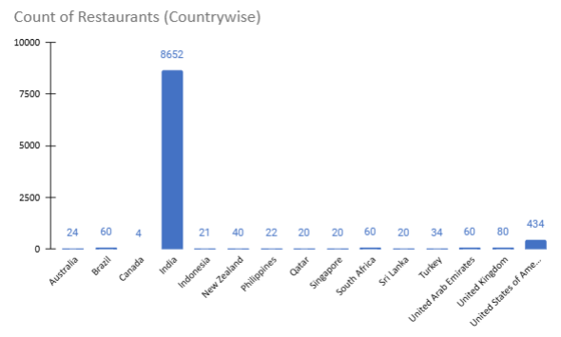
Restaurant Distribution by Country
Dominant Market: India stands out with the overwhelming majority of restaurants in the dataset (8,652), indicating Zomato's strong home market presence.
Secondary Market: The USA has a significant but much smaller presence with 434 restaurants.
Emerging Markets: Canada currently has the fewest restaurants (4), illustrating a market with very low current saturation.
The majority of other countries in our dataset have a significantly lower number of restaurants (less than 80). This disparity highlighted potential markets with less competition for new entrants.

Slide 9
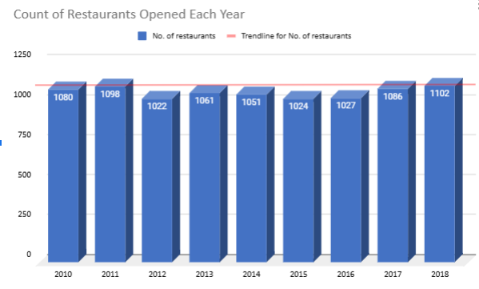
Yearly Restaurant Openings Trend
The number of restaurants opening each year shows a relatively stable trend over time, without dramatic fluctuations.
This suggests a consistent and steady rate of restaurant expansion over the years analyzed, rather than rapid acceleration or decline.

Slide 10
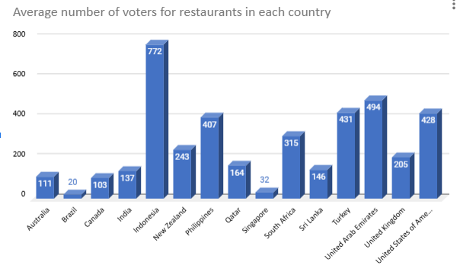
Customer Engagement by Country
High Engagement: Indonesia shows the highest average number of voters per restaurant, indicating very strong customer engagement.
Above Average Engagement: The UAE, Turkey, the USA, and the Philippines also demonstrate strong customer engagement levels, above the overall average.
Lower Engagement: Brazil and Singapore show comparatively lower average voters per restaurant.

Slide 11
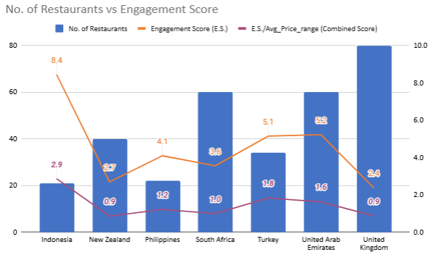
Recommended Countries For Expansion
To pinpoint optimal countries for Zomato's expansion,
I prioritized markets with high customer engagement
and less restaurant competition.
Indonesia: Identified for its relatively lower number of existing restaurants and high level of customer engagement.
Philippines: Also shows a promising combination of fewer restaurants and strong customer interest in dining.
Turkey: Presents an attractive market with less competition and a good level of customer engagement.
United Arab Emirates: Demonstrates strong customer engagement alongside a manageable number of existing restaurants.
These countries offer a favorable environment for new restaurant openings due to the balance of lower competition and significant customer demand.

Slide 12
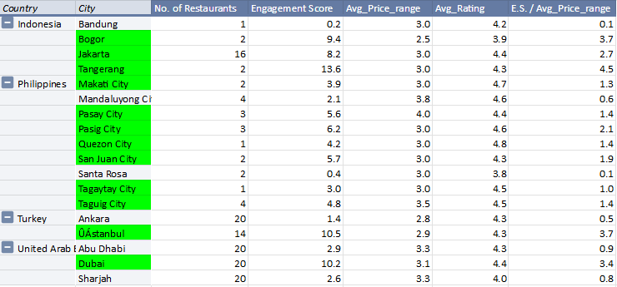
Recommended Cities in these Countries
Top City Recommendations:
Indonesia: Bogor, Jakarta, Tangerang
Philippines: Makati, Pasay, Pasig, Quezon, San Juan, Tagaytay, Taguig
Turkey: ÛÁstanbul
United Arab Emirates: Dubai
These cities, located within our top-recommended countries, were specifically selected because they also exhibit a strong balance of customer engagement and a suitable average price range, making them promising locations for new restaurant ventures.

Slide 13
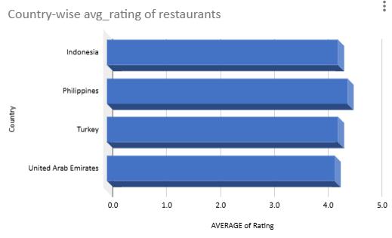
Restaurant Quality in Suggested Countries
Our analysis of customer ratings shows that the average rating for restaurants in Indonesia, Philippines, Turkey, and the United Arab Emirates is consistently above 4 out of 5 stars.
This indicates a generally high level of quality and customer satisfaction with the existing dining options in these markets.
Key Takeaway: To effectively compete, new restaurants will need to offer exceptional quality in both food and service to meet or exceed these existing standards and attract customers.

Slide 14
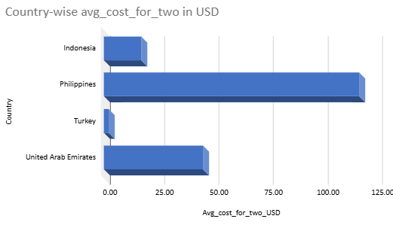
Dining Expenditure in Expansion Markets
Philippines: Approximately $120 - Indicating a higher average spending on dining out.
United Arab Emirates: Approximately $50 - Representing a mid-range average cost.
Indonesia & Turkey: Under $25 - Suggesting more affordable dining options on average.
Key Takeaway: The significant variation in average dining costs across these markets necessitates careful financial planning and tailored pricing strategies for new restaurants in each country.

Slide 15
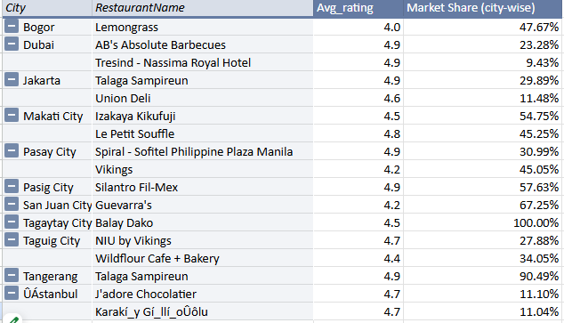
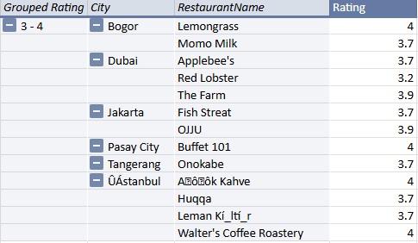
Competiton Landscape in Suggested Cities
Top Competitors
Lower-rated Restaurants
In each of the recommended cities, we identified established restaurants with significant customer popularity (based on votes) and high average ratings.
Our analysis of restaurants with lower ratings (3-4 stars) indicates a generally good standard of quality across the board. There were no restaurants rated below 3 stars in our data.

Slide 16
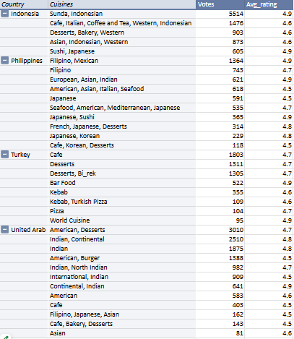
Optimal Cuisines for New Restaurants
Indonesia: Focus on Indonesian and Western cuisines, which show high popularity and ratings.
Philippines: Consider Filipino, Mexican, Asian, and Japanese cuisines, all well-received by customers.
Turkey: Cafe, Desserts, and Bar Food options are popular and highly-rated.
United Arab Emirates: American, Desserts, Indian, and Continental cuisines are recommended based on customer preferences.
Key Consideration: Prioritizing these cuisines in your new restaurants will align with local tastes and has the potential to lead to better customer feedback and higher ratings.

Slide 17
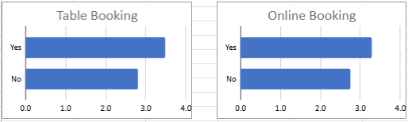
Impact of Online Delivery & Table Booking on Ratings
Table Booking: Restaurants offering table booking have a significantly higher average rating (3.5 stars) compared to those without (2.8 stars).
Online Delivery: Restaurants providing online delivery also achieve a higher average rating (3.3 stars) versus those not offering it (2.2 stars).
Key Takeaway: Offering both table booking and online delivery services has a clear positive impact on customer ratings, suggesting increased convenience and satisfaction.

Slide 18
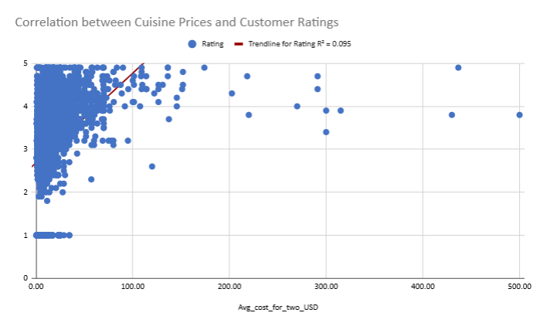
Price vs. Ratings: Is There a Link?
Analysis reveals a very weak positive correlation (R² = 0.095) between cuisine price and restaurant ratings.
Restaurants at lower price points achieve the full spectrum of ratings (1-5 stars).
Higher-priced restaurants (>$200 USD) tend to avoid the lowest ratings, but higher prices don't guarantee top ratings.
Key Takeaways: (1) Increasing prices alone is not a reliable strategy to improve customer ratings. (2) Customer satisfaction is likely driven by factors other than just price, such as food quality, service, and overall experience.

Slide 19
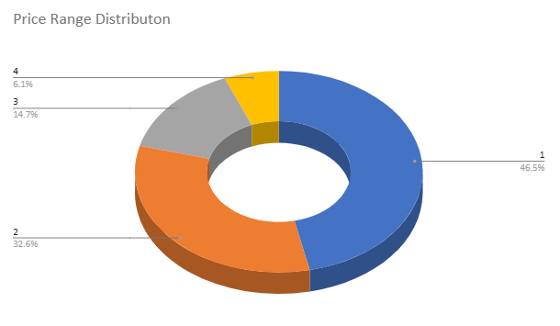
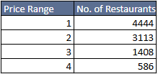
Restaurant Distribution by Price Range
Price Range 1 (46.5%) has the largest portion of restaurants, indicating a strong presence of more budget-friendly options.
Price Range 2 (32.6%) also represents a significant segment of moderately priced restaurants.
Price Range 3 (14.7%) constitutes a smaller portion of mid-to-higher priced establishments.
Price Range 4 (6.1%) represents the smallest segment, consisting of the most expensive dining options.
This distribution highlights that the majority of the restaurant market in the analyzed countries caters to the more affordable and moderately priced segments.

Slide 20

Conclusion
Our data analysis identifies Indonesia, Philippines, Turkey, and the United Arab Emirates as promising markets for new restaurant ventures due to lower competition and strong customer engagement.
Within these countries, focusing on recommended cities offers the most immediate potential.
To thrive in these markets with already high average restaurant ratings, prioritize offering high-quality food and service, along with cuisines that align with local preferences.
Enhancing customer convenience through online delivery and table booking is strongly recommended to boost satisfaction and ratings.
Adopt a value-driven pricing strategy, recognizing the prevalence of restaurants in the lower to mid-price ranges.

Slide 21
Acknowledgements & References
Data Source: Synthetic restaurant dataset provided by NewtonSchool for project-based learning.
Currency Conversion Data: Exchange rates sourced from Google Search, data accessed on February 18, 2025.
Analysis & Visualization Tools: Google Sheets was the primary tool used for data analysis and creating visualizations.
Presentation Tool: WPS Office was utilized for the creation of this presentation.
Thank you to the NewtonSchool team for providing the dataset and project guidelines.

Slide 22
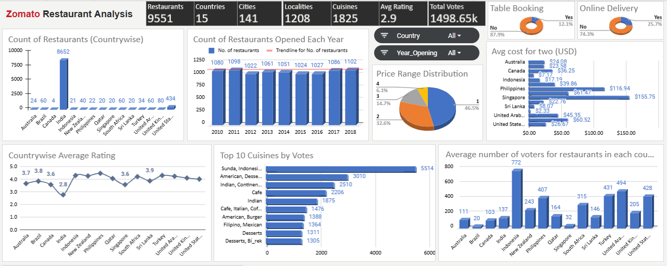
DASHBOARD
Link: https://docs.google.com/spreadsheets/d/1vgzjCM8Cc1GuayzqSDzFkmT3ia6OG2f7FO-dhp8RD4I/edit?usp=sharing

